Slide 1
IPL DATASET
NAME : SREEJAA R G
DATE: 01-09-2025

Slide 2
Agenda
Introduction
Dataset Description
Data Preprocessing
Exploratory Data Analysis (EDA)
Model Building
Model Tuning & Evaluation
Insights
Conclusion

Slide 3
INTRODUCTION
EMPHASIZE YOUR POINTS THROUGH YOUR DIALOGUE
The IPL dataset contains detailed information about 756 matches across 18 features, covering multiple seasons of the Indian Premier League (IPL). Each row represents a single match with attributes such as season, date, city, teams, toss results, match outcome, winning margin (by runs or wickets), player of the match, and venue.
This dataset provides valuable insights into the performance of teams and players, the impact of toss decisions, and match outcomes. It is widely used in sports analytics, predictive modeling, and visualization to uncover trends and patterns in one of the most popular cricket leagues in the world.

Slide 4
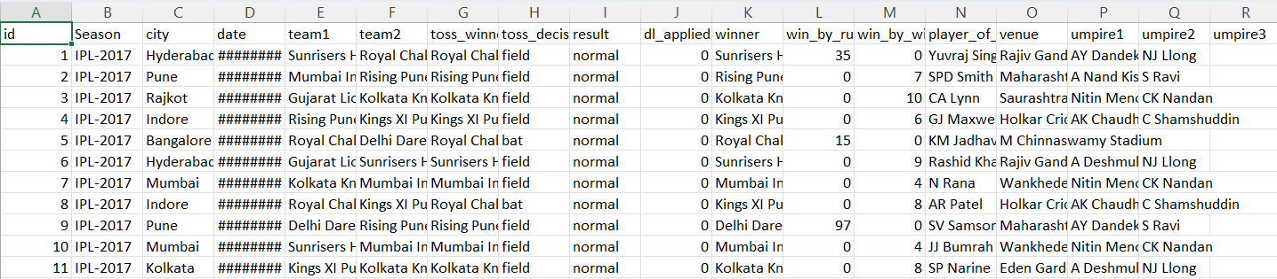
DATA UNDERSTANDING
id → Unique match identifier.
Season → IPL season in which the match was played.
city → City where the match was held.
date → Date of the match.
team1 → First competing team.
team2 → Second competing team.
toss_winner → Team that won the toss.
toss_decision → Decision taken after winning toss (bat or field).
result → Result type (normal, tie, no result).
dl_applied → Duckworth-Lewis method applied (1 = Yes, 0 = No).
winner → Match-winning team.
win_by_runs → Margin of victory in runs (if the team batted first).
win_by_wickets → Margin of victory in wickets (if the team chased).
player_of_match → Best performing player (MVP).
venue → Stadium where the match was played.
umpire1, umpire2, umpire3 (if present) → Match officials.
EMPHASIZE YOUR POINTS THROUGH YOUR DIALOGUE

Slide 5
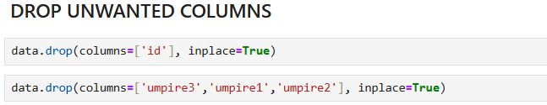

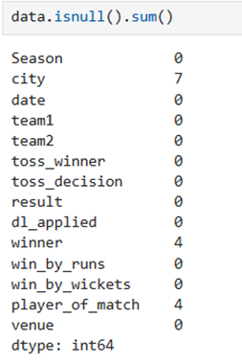
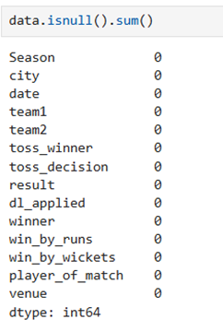
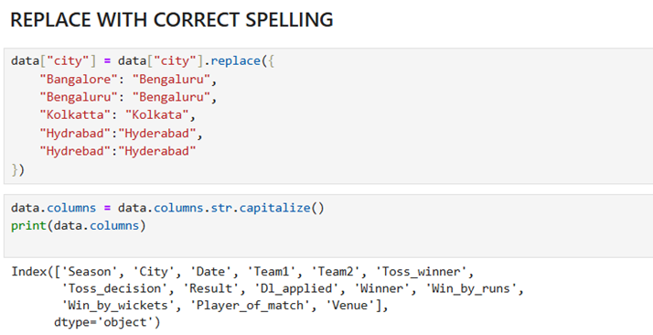
DATA CLEANING
Identifying Issues
Missing Values
Inconsistent Categories
Unnecessary Columns
Data Types

Slide 6
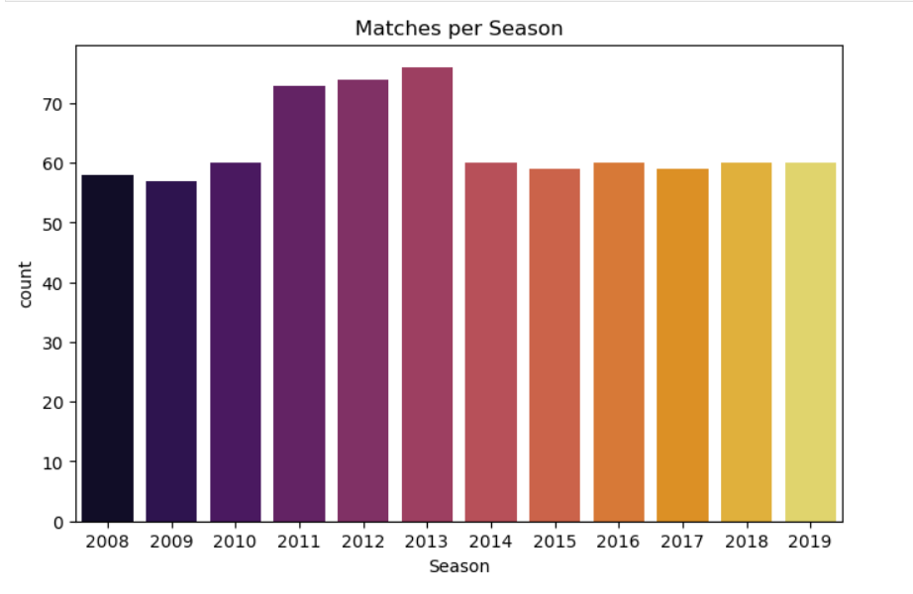
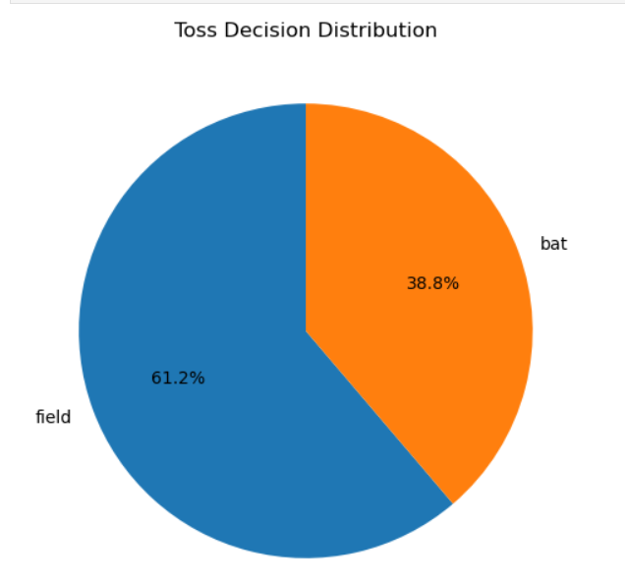
EXPLORATORY DATA ANALYSIS (EDA):

Slide 7
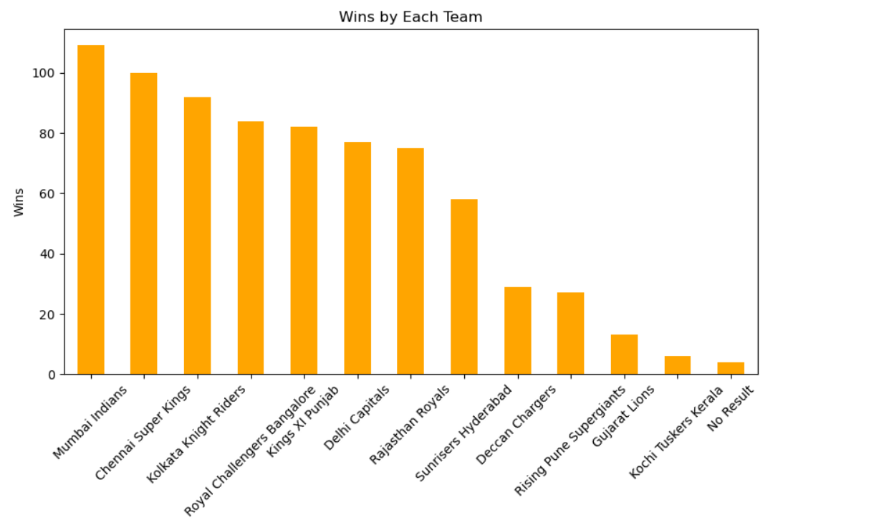
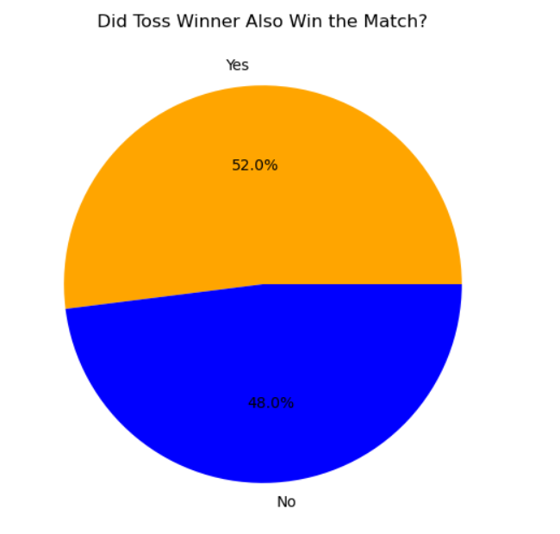
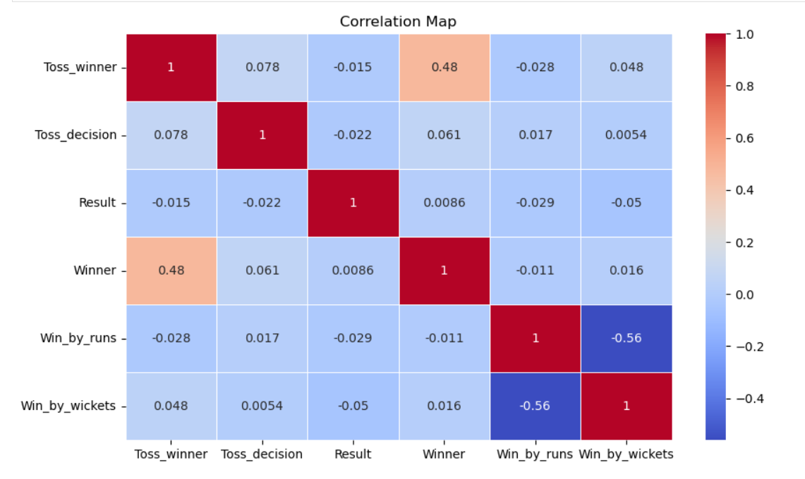
(EDA):

Slide 8
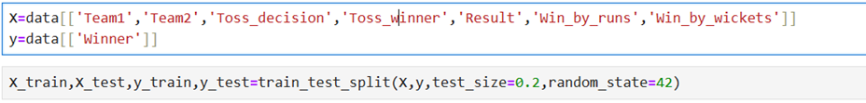
MODELING PROCESS
Feature Selection
Model Selection:
Logistic Regression – Simple baseline for binary/multiclass classification.
Decision Tree Classifier – Captures non-linear relationships between features.
Random Forest Classifier – Ensemble model improving accuracy and reducing overfitting.
Support Vector Machine (SVM) – Effective for classification with high-dimensional data.
K-Nearest Neighbors (KNN) – Based on similarity between feature vectors.
XGBoost Classifier – Gradient boosting algorithm for high performance on tabular data.

Slide 9
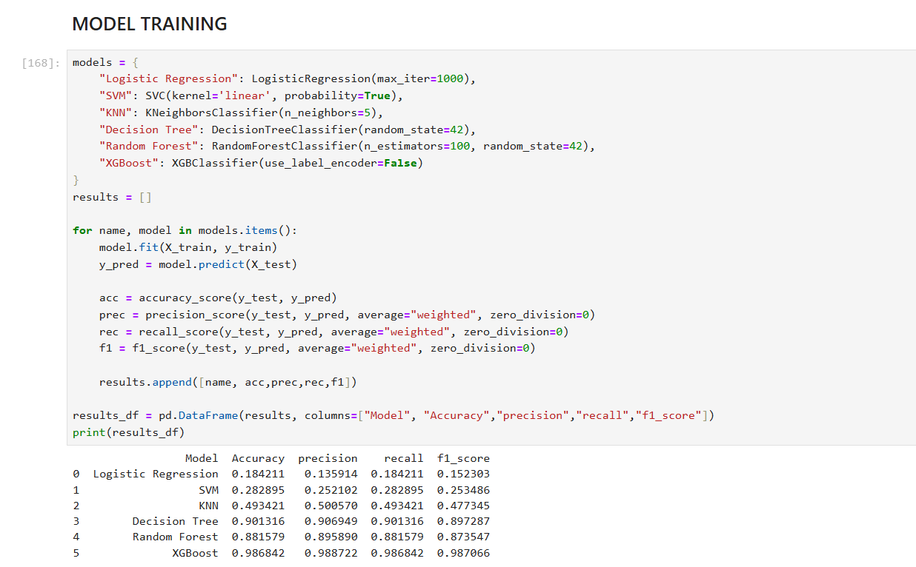
MODELING PROCESS

Slide 10
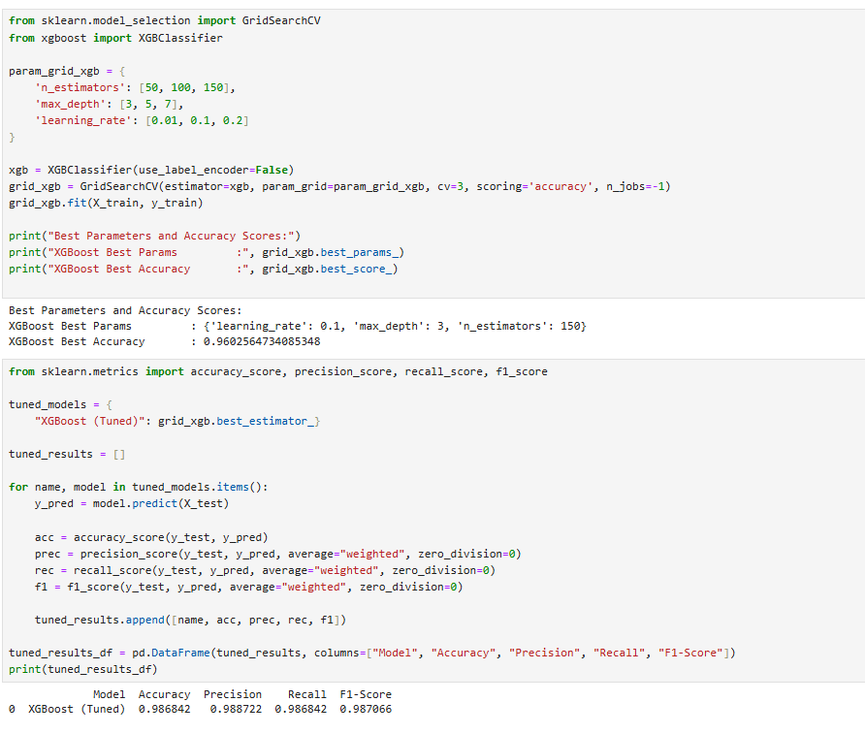
HYPERPARAMETER TUNING

Slide 11
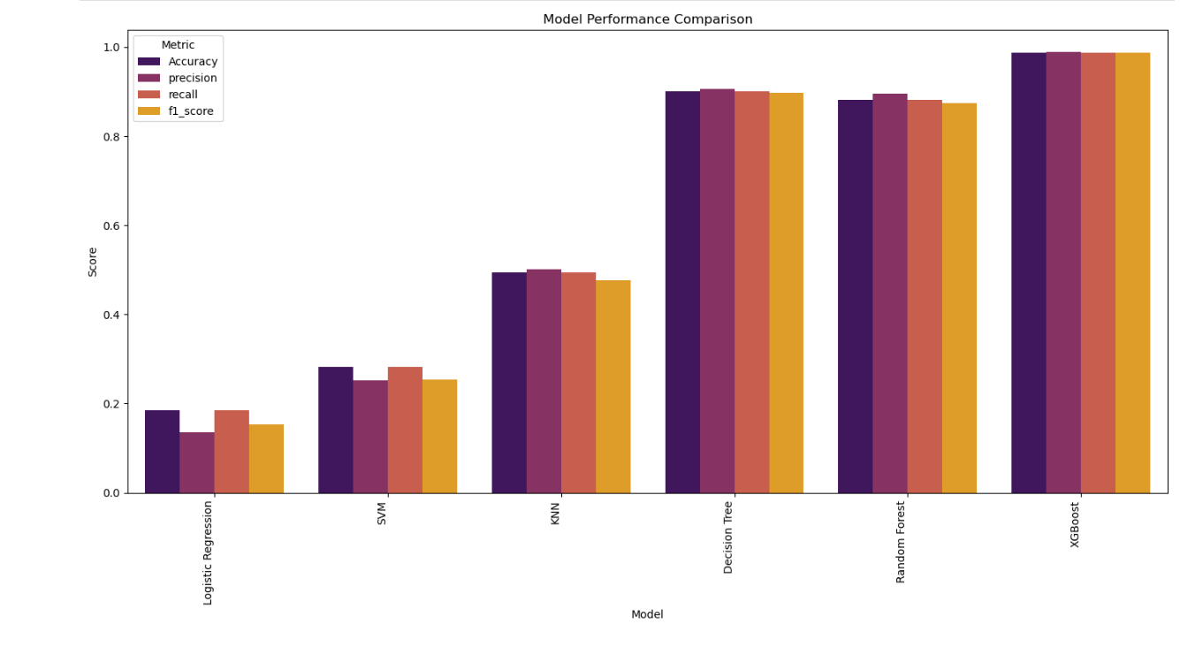
MODEL COMPARISON
Compare all models based on evaluation metrics

Slide 12
CONCLUSION & INSIGHTS:
The IPL dataset provides comprehensive information on matches, teams, and player performances across seasons. Analyzing this data helps uncover trends such as team strengths, top-performing players, and the influence of toss or venue on match outcomes. By applying preprocessing, exploratory analysis, and predictive modeling, meaningful insights can be drawn, and match outcomes can be predicted with reasonable accuracy. The dataset serves as a valuable resource for sports analytics, strategy planning, and data-driven decision-making in cricket.
Mumbai Indians and Chennai Super Kings are the most consistent teams across seasons.
Toss decisions can influence match outcomes, but team strength is more important.
Top-performing players often win multiple Player of the Match awards, showing consistency under pressure.
Most matches are closely contested, with occasional high-margin victories.
Venue and season trends affect team performance, indicating strategic advantages.

Slide 13
THANK YOU

